Slide 1

M.L Automation with DevOps
-by Sudha rani

Slide 2
Automation of the Machine Learning model to gain better accuracy using JENKINS jobs and training using Docker…
Complete integration based on mlops

Slide 3
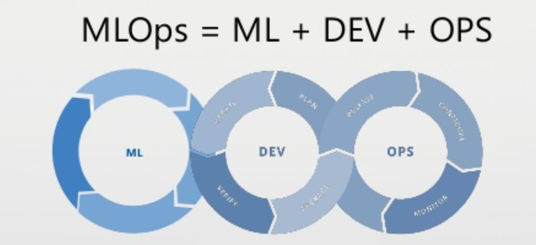
JOB-1
JOB-2
JOB-3
=> Pull the GitHub repository automatically when developers push repo to GitHub
=> By looking at the code Jenkins should automatically start the software installed Docker container
=> Train the model and predict accuracy or metrics

Slide 4
JOB-4
JOB-5
JOB-6
=>If metrics is less than 80% then tweak the Machine Learning model architecture
=> Notify that the best model is created to the client
=> If container fails from where it is running then this job should automatically start the container again from where the last trained model left

Slide 5
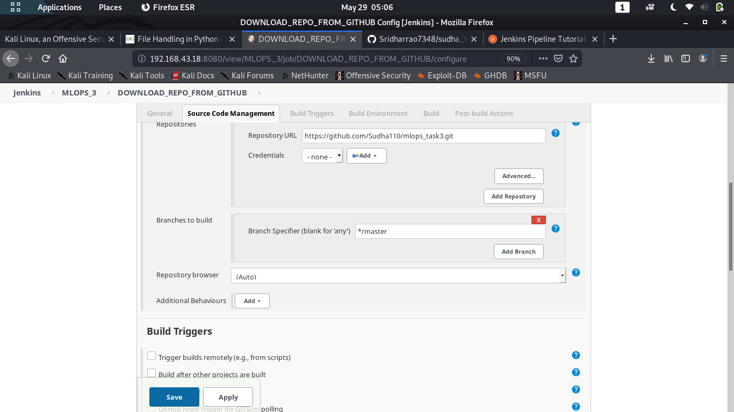
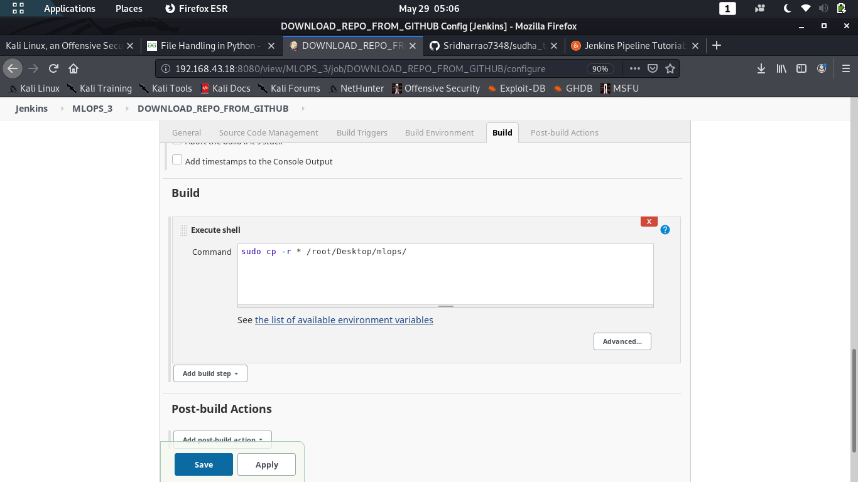
JOB – 1 DOWNLOADING GitHub Repo

Slide 6
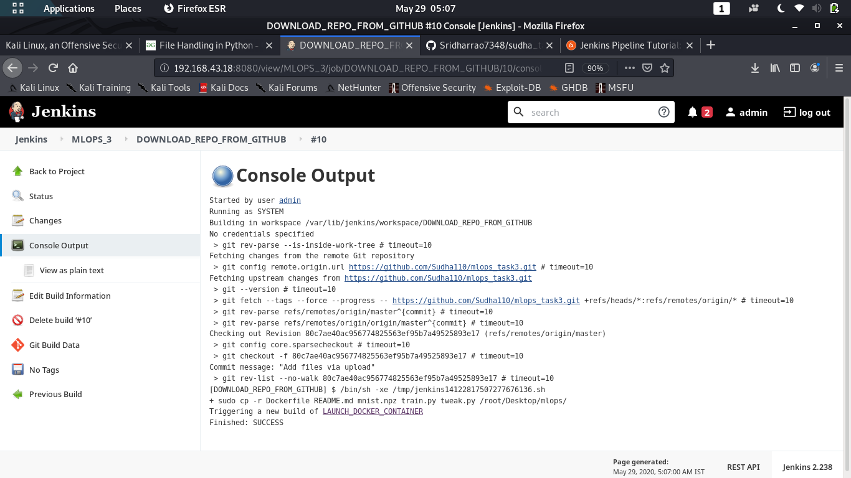
JOB -1 CONSOLE OUTPUT

Slide 7
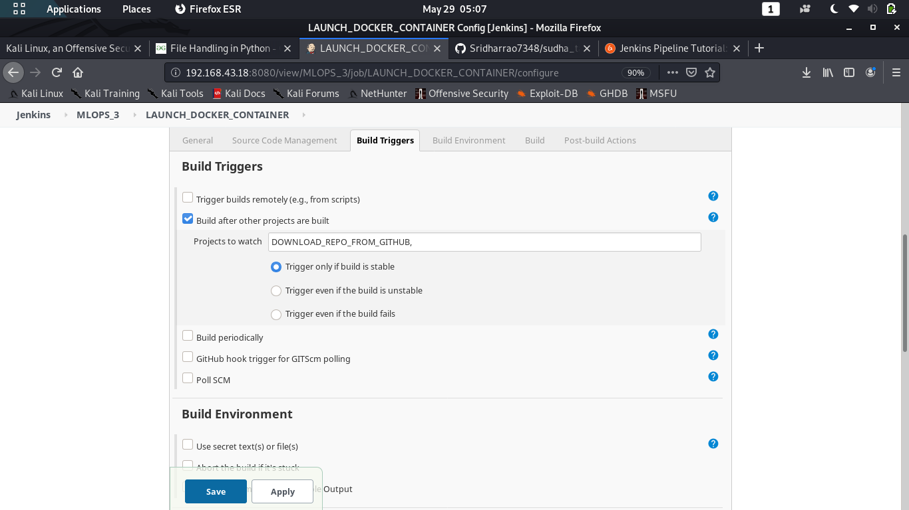
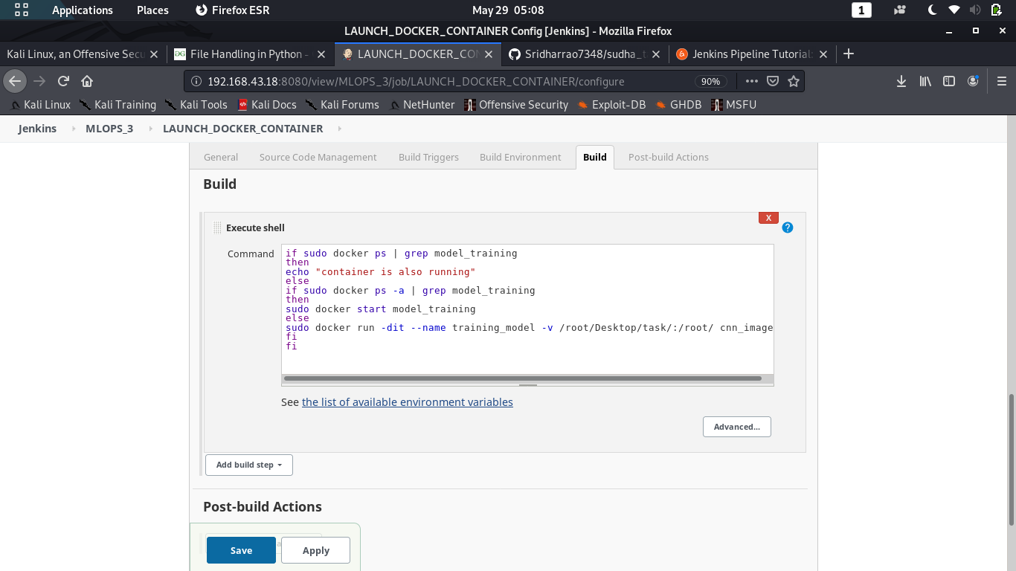
JOB – 2 LAUNCHING DOCKER

Slide 8
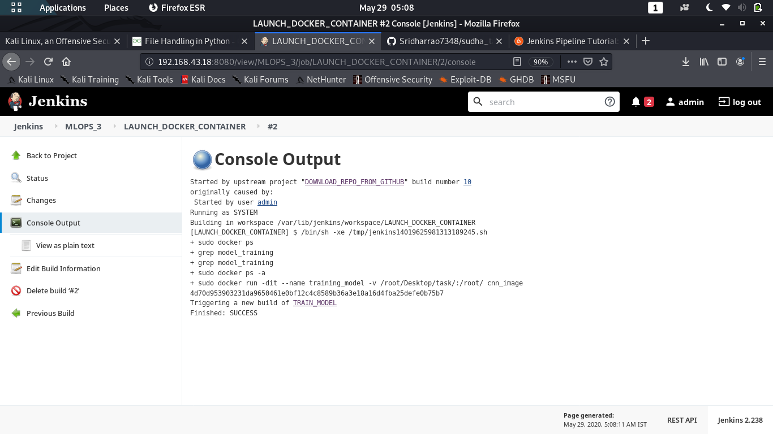
JOB -2 CONSOLE OUTPUT

Slide 9
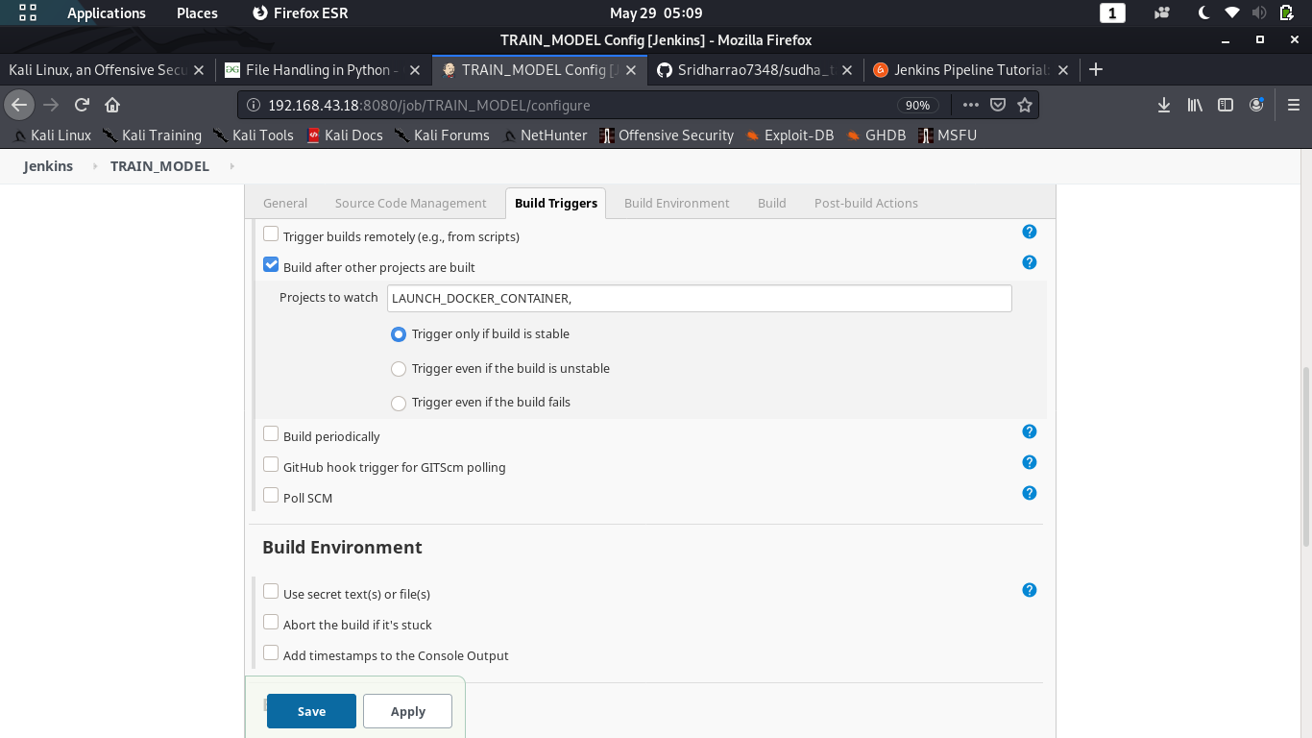
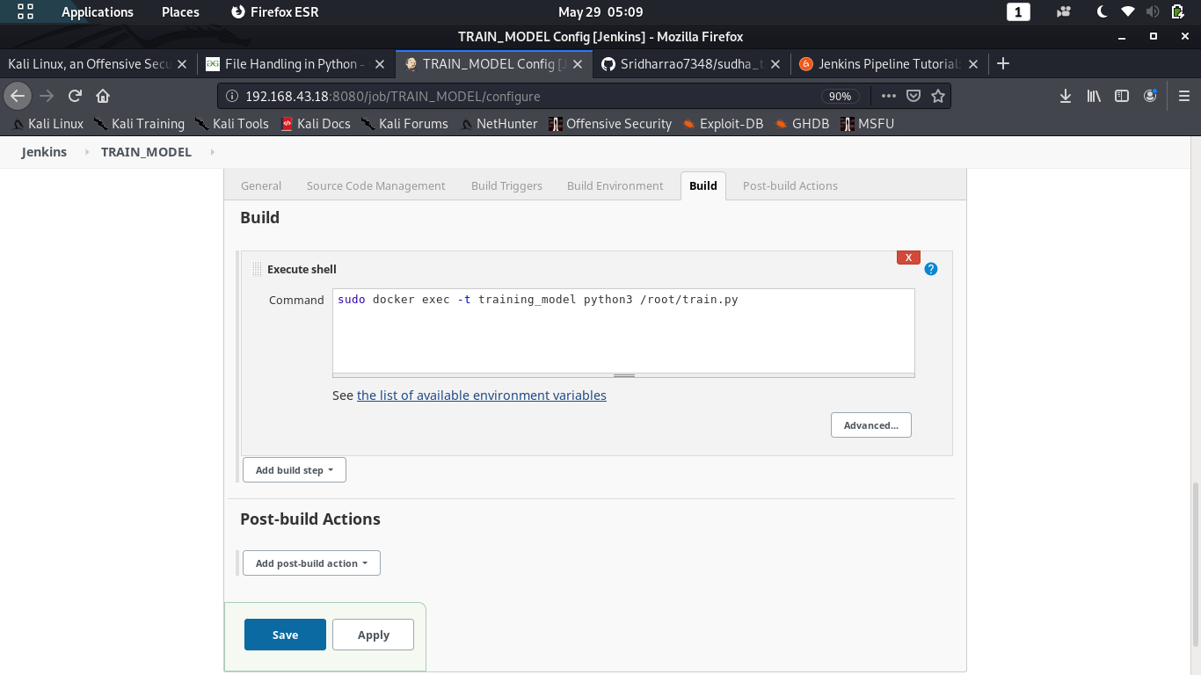
JOB – 3 TRAINING MODEL

Slide 10
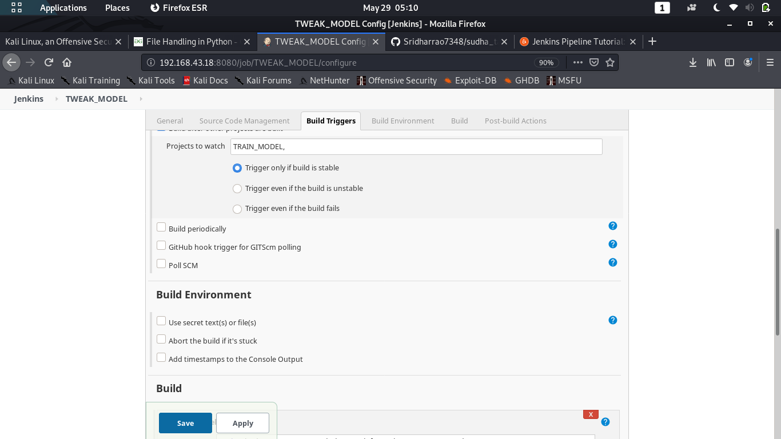
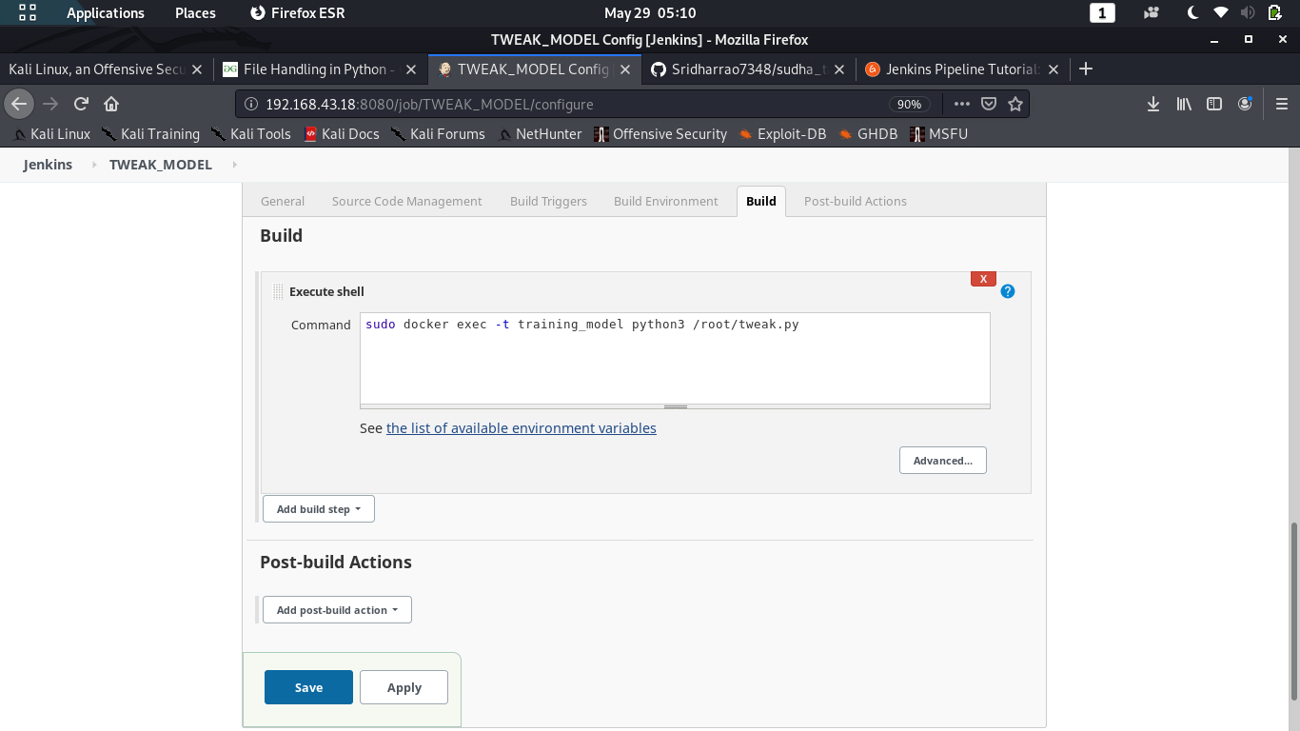
JOB – 4 TWEAKING MODEL

Slide 11
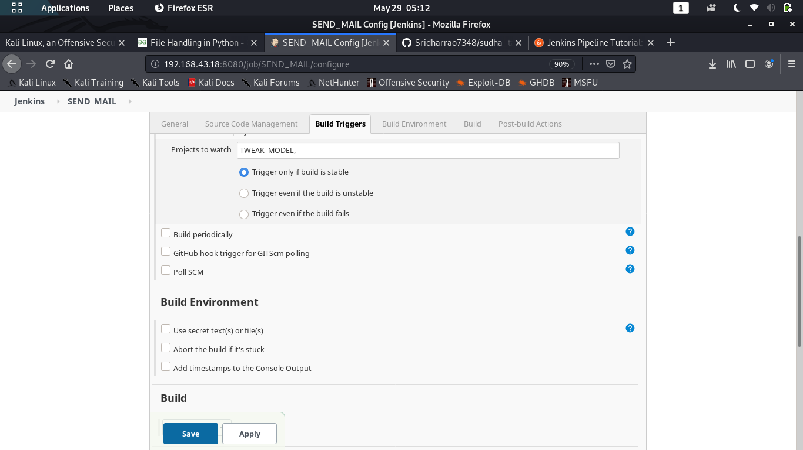
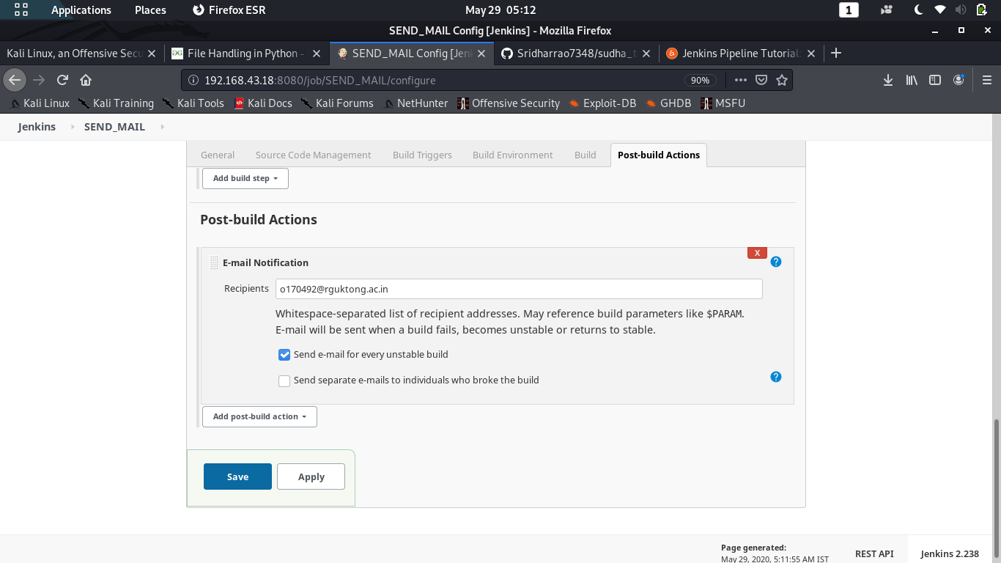
JOB – 5 SENDING MAIL TO THE CLIENT

Slide 12
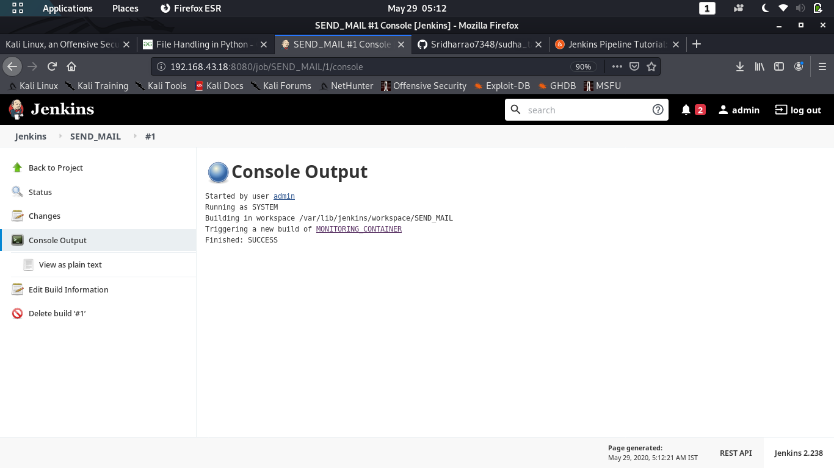
JOB – 5 CONSOLE OUTPUT

Slide 13
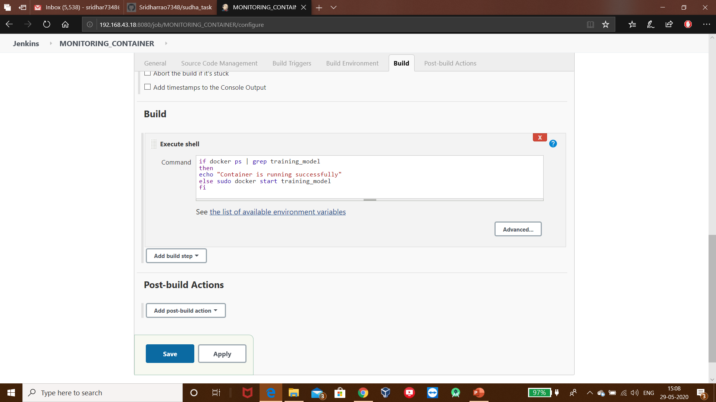
JOB – 6 MONITORING CONTAINER

Slide 14
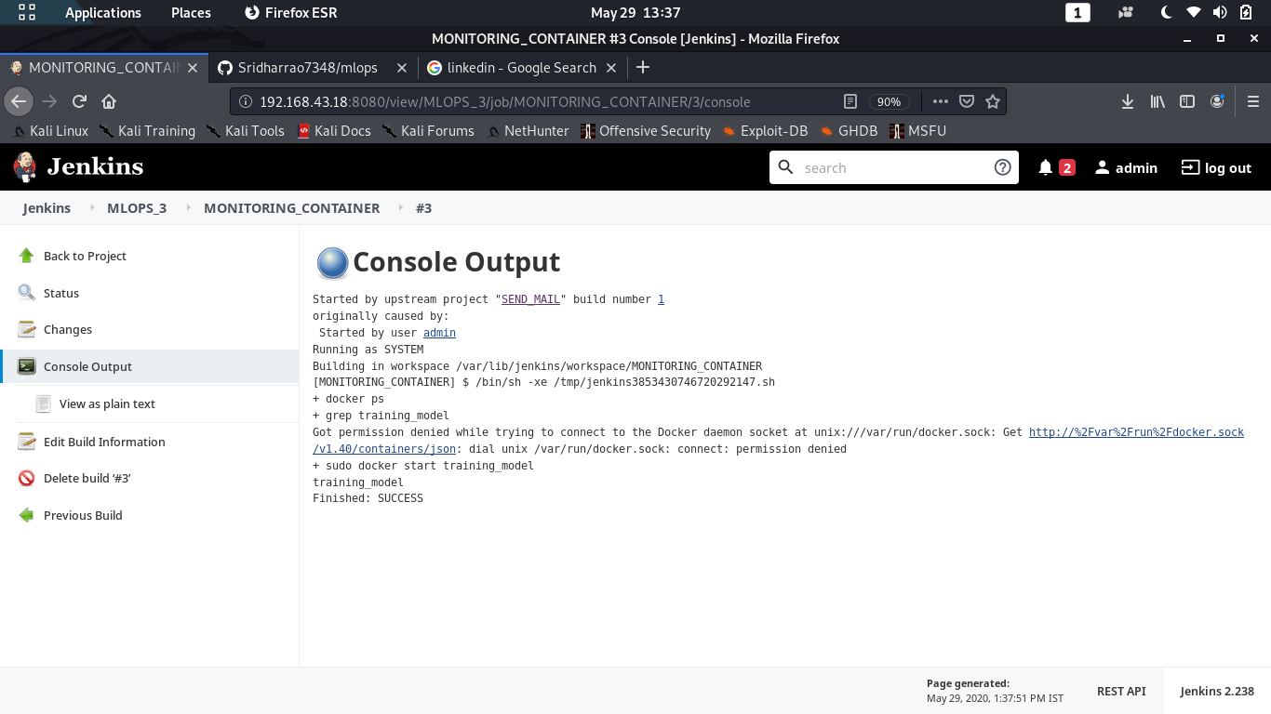
JOB – 6 CONSOLE OUTPUT

Slide 15
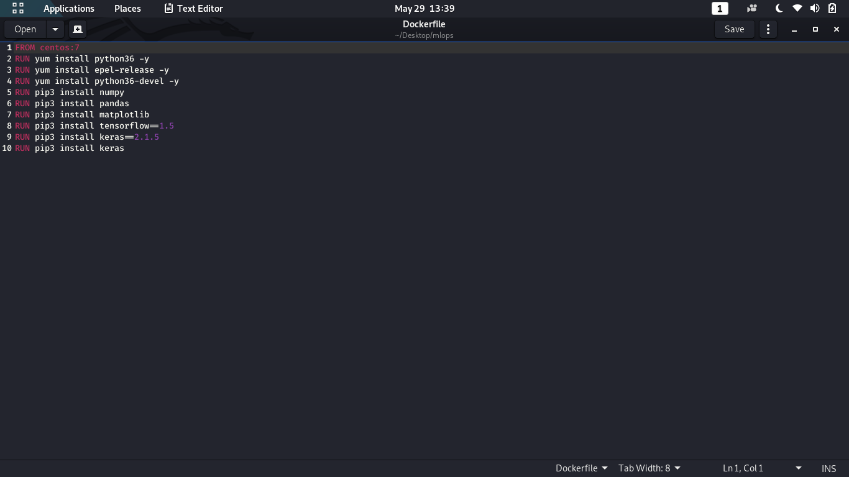
Dockerfile

Slide 16
The process done in between Training and Tweaking jobs of Jenkins
After training the model if we got less accuracy than the 95% then the return code “1” or “0” (“1” if we got desired result and “0” if we didn’t get desired result will be returned to a file and after that Jenkins Tweak the model based on return code .If Tweaking job find the “0” as return code then the model is retrained by adding some more layers and changing the hyper parameters.

Slide 17
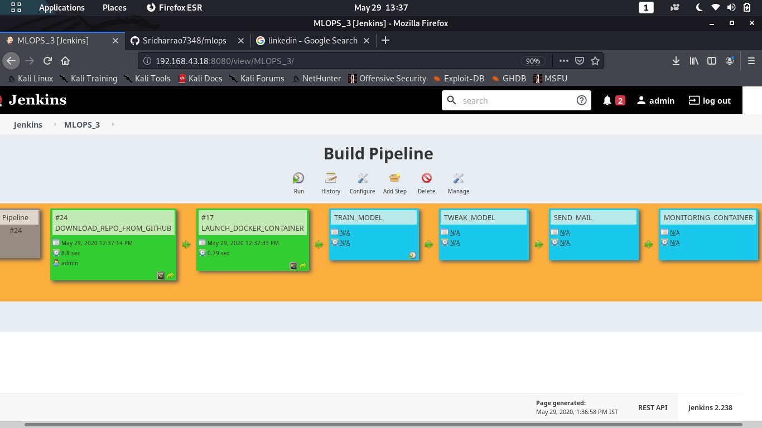
PIPELINE VIEW OF ALL JOBS

Slide 18


